Slide 1

Trait-Based Functional Ecology Paola Barajas & Emma Ladouceur paola.barajas@idiv.de emma.ladouceur@idiv.de
Elizabeth Builes
@mira.pal.cielo

Slide 2

Biodiversity
Includes genotypic and phenotypic variation, and evolutionary histories of organisms across space and time.
Its quantification is challenging. Large part of this quantification deals with the number of species and their abundances:
“Taxonomic facet”
Elizabeth Builes

Slide 3
Biodiversity
Other facets:
“Phylogenetic facet”: reconstructs the origins of life and evolution, i.e., tree of life.
“Functional facet”: deals with organisms/species functional characteristics in relation to the environment.

Slide 4
Biodiversity
Focus: “Functional facet”
Its ecological importance relates to communities and ecosystem dynamics, stability, productivity, nutrient balance.
Tilman 2001

Slide 5
Functional ecology
Studies organismal ecology, including physiological ecology, behavioral ecology and evolutionary ecology, and their role/function in community and ecosystem patterns and processes.
Elizabeth Builes

Slide 6
Functional ecology
“Function” (the action of performing)
Relates to the role of organisms in their environment.
Reflects natural selection (environmental filters or competition) on an organism.
“Function” specific activity carried out by part of a whole or by the whole itself, e.g., species and ecosystems (scale).
Calow 1987 Func. Ecol; Garnier et al 2016
Elizabeth Builes

Slide 7
Functional ecology
Differences among species are quantified using morphological and physiological characteristics (“traits”) that impact how organisms respond to environmental factors, affect other trophic levels, and influence ecosystem properties.
Lavorel and Garnier 2002 Func. Ecol; Violle et al 2007 Oikos
Elizabeth Builes

Slide 8
Clarification: “Functional facet”
Functional diversity: the variation of traits between organisms that can be used to address ecological questions.
E.g., leaf sizes, canopy heights, or body size.
Dı́az & Cabido 2001 Trends Ecol. Evol.; Mason et al 2005 Oikos
Elizabeth Builes

Slide 9
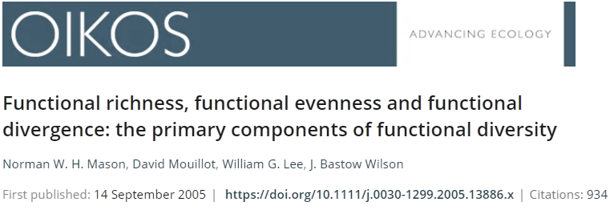
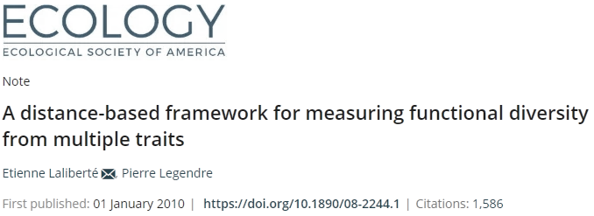

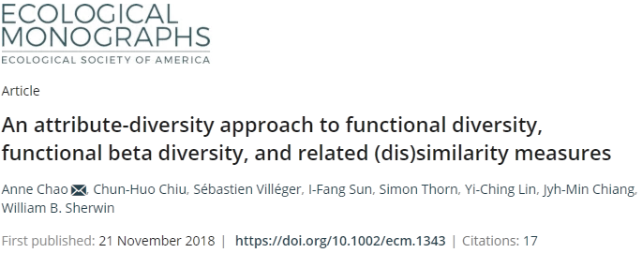
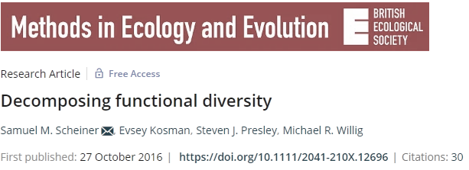
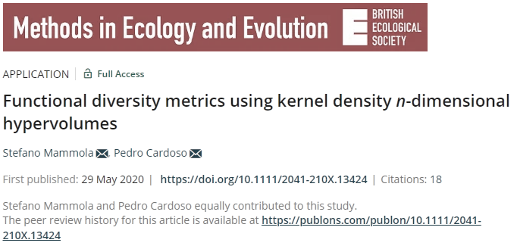
Methods

Slide 10
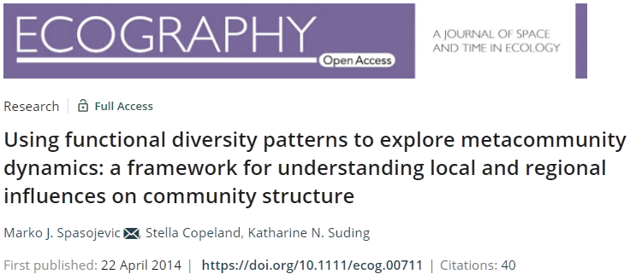
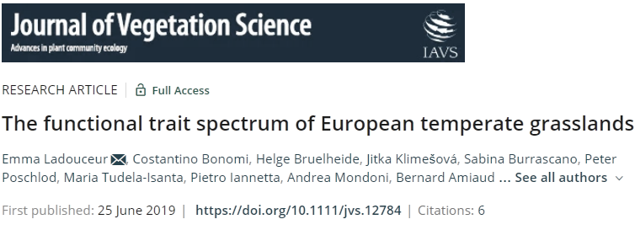
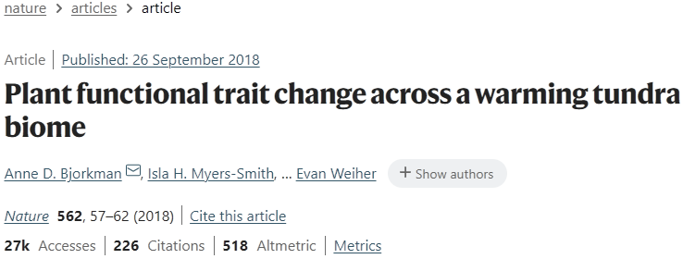
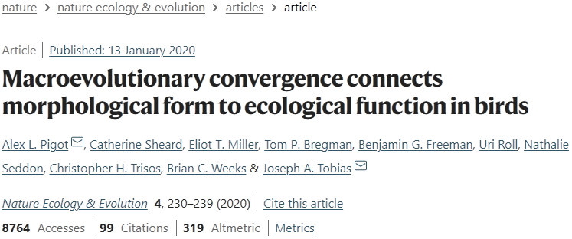

Address ecological questions

Slide 11

Traits and trait-based functional ecology
Elizabeth Builes

Slide 12
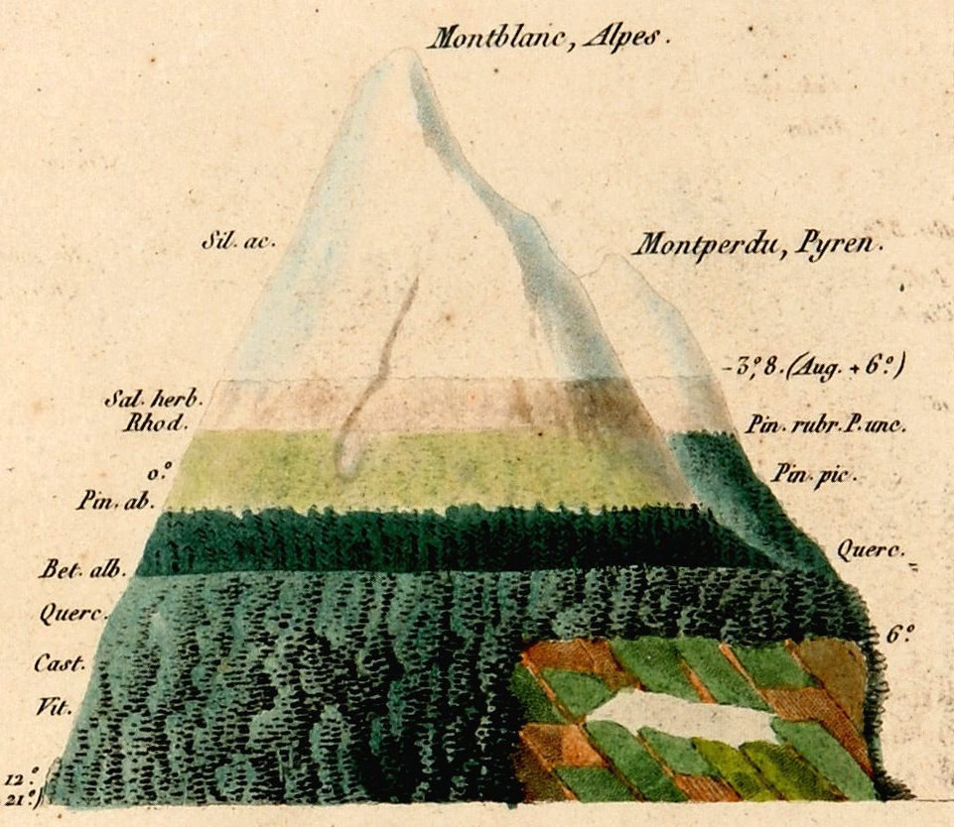
Trait-based functional ecology
‘Schimper world (1898)’
Certain species are more successful in different parts of the landscape than other because their attributes “traits”.
Climate and environmental attributes filter species based on their traits.
A. von Humboldt
Westoby & Wright 2006
Notes:
How come ecologist and biologist started thinking about functional diversity?
German Botanist Andreas Schimper (Pflanzengeographie auf Physiologischer Grundlage 1898) from the 18 hundreds.
In his world, some plant species are more successful in different parts of the landscape, and this is because they have different quantitative characteristics, such as leaf nitrogen concentrations, rooting depths, wood densities, leaf sizes and canopy heights. Schimper world is set in real physical geography, along gradients of rainfall, temperature, and geomorphology.
Plant stems, canopy architecture, foliage are so influential in terrestrial ecosystems that Schimper world should be important for any ecologist.

Slide 13
Trait-based functional ecology
The merit of traits
They facilitate comparisons: operability of systems around the world, regardless of their compositions (Raunkiaer 1937, Grime 1979).
Ecosystem management (e.g., wetlands) could be transferred or compared to different floras or geographical regions.

Slide 14
What are traits?
“Morphological, physiological, phenological characteristics of organisms that impact growth, reproduction and survival of individuals”
(Violle et al 2007)
“Traits affect how organism respond to environmental factors and affect ecosystem properties” (Lavorel & Garnier 2002)

Slide 15


Functional traits
Examples
Plant stature
Seed mass
Leaf area
Pollination syndrome (categorical)
Body size
Beak length
Wing length
Diet (categorical)
http://www3.gobiernodecanarias.org/medusa/wiki/index.php?title=Categor%C3%ADa:Flora_canaria

Slide 16
Functional traits Ecological functions
Seed mass
Vegetative height
Leaf size
Specific leaf area (SLA)
Leaf nutrients concentrations
Density root tissues
Toor depth or root length
Fecundity
Light interception, competitive ability
Resource acquisition
Growth (fast, slow)
Absorption (nutrients, water)
Survival under drought
Garnier et al 2016
http://www3.gobiernodecanarias.org/medusa/wiki/index.php?title=Categor%C3%ADa:Flora_canaria
Notes:
Specific leaf area (SLA; leaf area/leaf mass) important trait. SLA determines how much new leaf area to deploy for each unit of biomass produced.
Under elevated CO₂, any storage of the extra carbohydrate in the leaves or any reallocation of biomass to thicker leaves would tend to increase leaf mass more than leaf area, thereby decreasing SLA.
MORE MASS THAN AREA = low SLA

Slide 17
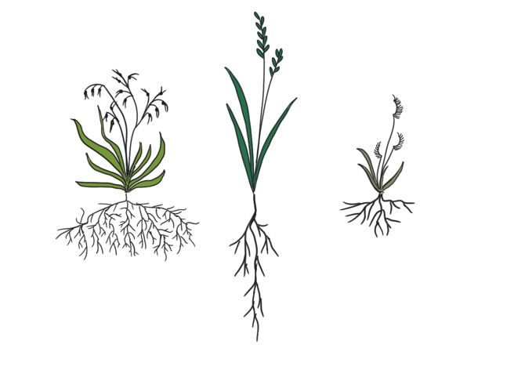
Trade-offs… because plants cannot do it all
Trade-off arise because evolutionary pressures select for specific traits in specific environments
Example: species with high specific leaf area may be best suited to thrive in resource-rich environments, whereas those with low SLA might be best at withstanding drought
High specific leaf area
High specific root length
Low tissue density
FAST growth
Low specific leaf area
Low specific root length
High tissue density
SLOW growth
@MagdaGarbowski

Slide 18
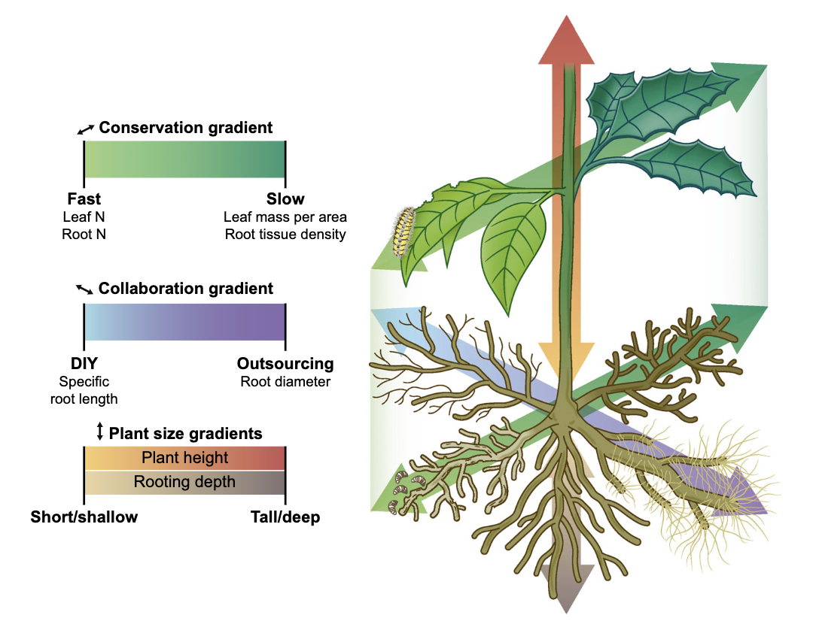
Plant ecological strategies
Weigelt et al 2021
Notes:
Coordinated variation in traits result in specific plant strategies.
The most studied strategy is that of the leaf economic spectrum which demonstrates that species adopt either “fast” or “slow” strategies related to resource acquisition.
”Fast” species would have high N concentrations and high specific leaf area. These traits or characteristics allow it to grow quickly. However, the leaves these species produce are not tolerant to stress and have short longevity. On the other side of this LES are slow species with high-density tissues and long leaf lifespans – these are often species more capable of withstanding stress.
Flimsy – lettuce/dandelion, resistant – pine trees, trees, shrubs
Recently root traits have been incorporated into this framework with two dominant axes of variation: one related to the “fast-slow” spectrum in leaves with some plants optimizing rapid resource acquisition and others optimizing root longevity and another related to collaboration with mycorrhizal partners.
In addition, “size” axes exists above and below ground under which plants are either short or tall and have either shallow or deep roots. However, in this study, the largest assessment of whole-plant variation to date, aboveground maximum height and belowground rooting depth were not correlated, but independent axes.
Tree’s tipped over after wind storm

Slide 19
Functional Traits + Ecology = Trait-based functional ecology
Trait-based functional ecology uses species traits to understand:
how species and communities respond to environmental change (Lavorel & Garnier 2002)
and predict how species enter, persist, and coexist in communities (i.e., community assembly) (HilleRisLambers et al 2012)

Slide 20
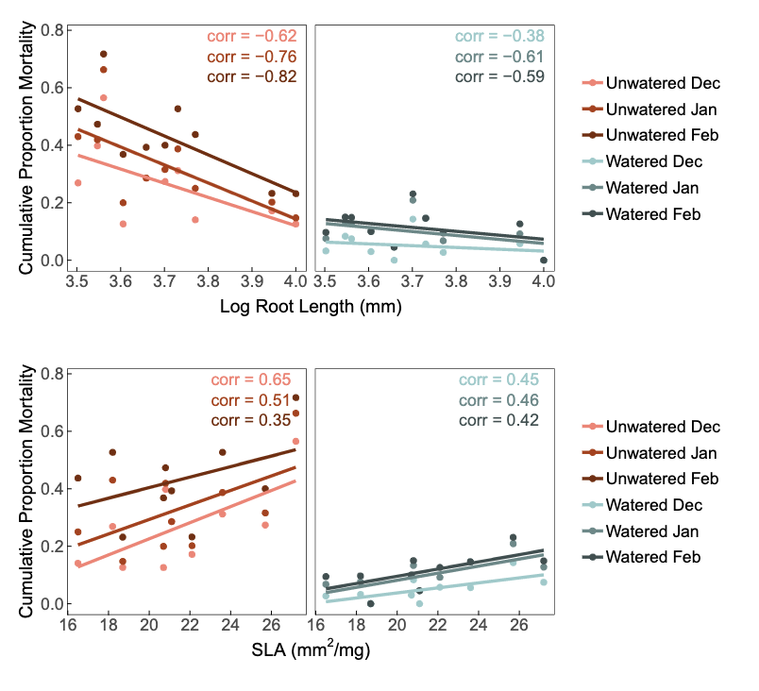


Trait-based functional ecology
Species and communities responses to environmental change
Example 1
Drought
Watered
Drought
Working in annual grasslands, Harrison and LaForgia (2019) found that species with long roots and low SLA, experienced lower mortality that those with short root and high SLA resulting from drought.
Harrison & La Forgia 2019

Slide 21
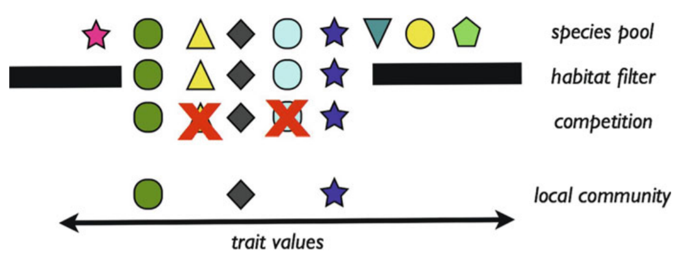
Trait-based functional ecology
Prediction of species arrival, persistence and coexistence in communities.
Conceptual model of community
assembly in terms of species functional
traits (phenotypes).
Community assembly
Kraft & Ackerly 2014

Slide 22
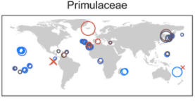
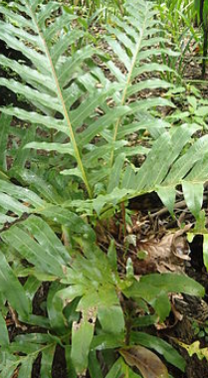
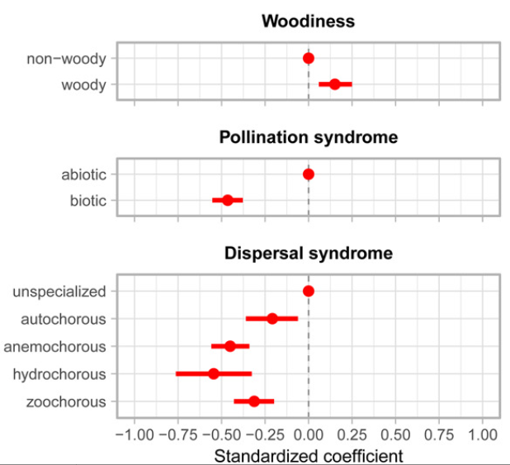
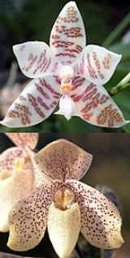
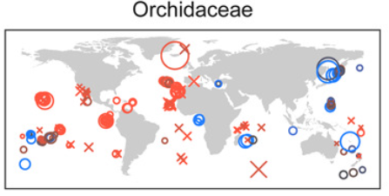
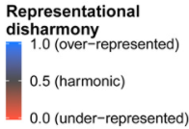
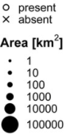
Trait-based functional ecology
Representational disharmony
Assembly of plant communities
Example 2
Disharmony results from selective assembly mechanisms (Carlquist 1974).
I.e., Dispersal filtering, environmental filtering and biotic filtering.
König et al 2020

Slide 23
Functional traits
Examples
Plant stature
Seed mass
Leaf area
Pollination syndrome (categorical)
Body size
Beak length
Wing length
Diet (categorical)
http://www3.gobiernodecanarias.org/medusa/wiki/index.php?title=Categor%C3%ADa:Flora_canaria

Slide 24
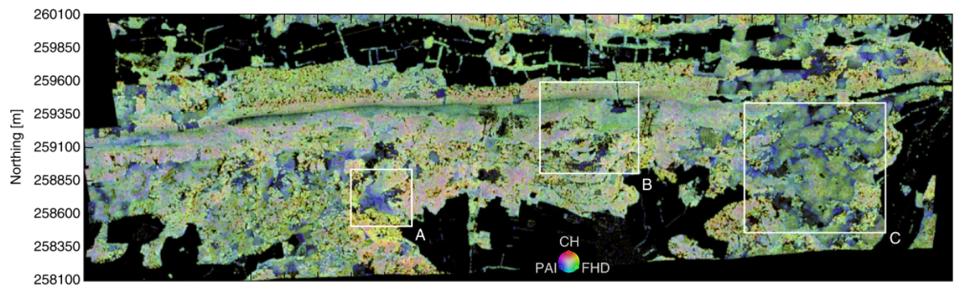
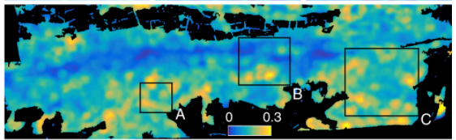
Trait-based functional ecology
Other types of traits: Functional diversity from space
Three physiological traits
Laser scanning + imaging spectroscopy
Leaf chlorophyll
Leaf carotenoids
Equivalent water
thickness
Photosynthetic activity
Physiological richness
Plant responses
to drought
Schneider et al 2017

Slide 25
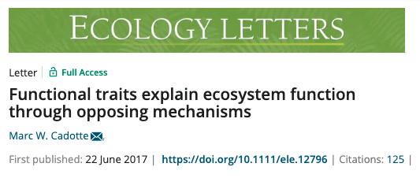
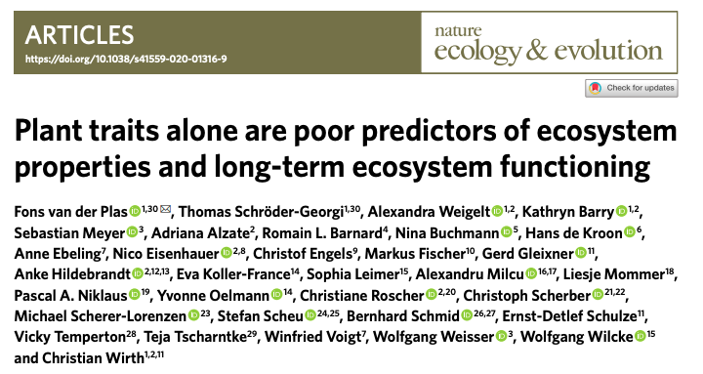
Take home messages
Trait based approaches are important complementary ways to understand diversity patterns and processes.
This is true when the traits selected can relate to species, communities, metacommunities and ecosystems dynamics.

Slide 26
Take home message
Which traits should we measure?
We can start asking what are the functions that organism perform and which traits or proxies of traits most effectively measure those functions.
Three main functions:
1. Resource acquisition
2. Ability to tolerate environmental extremes
3. Ability to compete with neighbors
Keddy 1992

Slide 27
Quantification of functional trait diversity
Elizabeth Builes

Slide 28
Anne Chao et al approach
Hill numbers (effective number of species) are extended to functional diversity, which considers the differences among species traits.
Their framework unifies ecologists’ measures of species diversity, with distance-based functional diversity.
Based on species-pairs with unit-distance between species

Slide 29
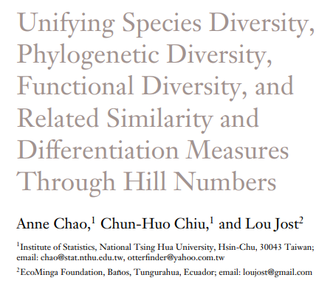
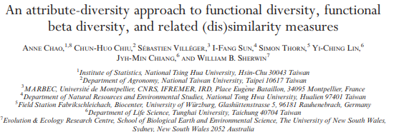
Chao, A., Chiu, C. H., & Jost, L. (2014). Annual review of ecology, evolution, and systematics, 45, 297-324.
Chao, A., Chiu, C. H., Villéger, S., Sun, I. F., Thorn, S., Lin, Y. C., ... & Sherwin, W. B. (2019). Ecological Monographs, 89(2), e01343.

Slide 30
Recap about hill numbers
The Hill numbers are 'effective number of species' (Hill 1973; Jost 2006).
The parameter q determines the sensitivity of the measure to the relative abundance of species.
q = 0, is species richness. It counts species equally without regard to their relative abundances.
q = 1, is Shannon diversity, q = 1 counts individuals equally and weighs each species in proportion to its abundances.
q = 2, referred to as Simpson diversity, disproportionately favors dominant species.
Notes:
Hill numbers are a mathematically unified family of diversity indices (differing among themselves only by an exponent q) that incorporate relative abundance and species richness.

Slide 31
How are functionally distinct species defined?
Pool of species
Functional traits
Functional distance
between species
Sp1 Sp2 Sp3
Trait 1 Trait 2
Sp1 Sp2 Sp3
Site 2 site 1
Sp3 Sp2 Sp1
Sp3 Sp2 Sp1
Euclidean or Gower’s
distance
Modified from Maire et al 2015
Notes:
What is the additional information that FD metric includes?
A distance matrix, that is based on species traits.
Species by trait matrix
Distance matrix

Slide 32

Level of threshold distinctiveness
Tau: level of threshold functional distinctiveness
Determine a threshold level: any two species with distance greater than or equal to the specified threshold level will be functionally different.
Species are placed in a functional space with an specified pairwise distances
Cluster species into “virtual functional groups”
Chao et al 2019
Notes:
Clustering algorithm: imagine that all species are placed in a functional space with specified pairwise distances, and now we cluster them into “virtual functional groups.” As in most statistical clustering algorithm, one must first determine a threshold level such that any two species with distance greater than or equal to the specified threshold level are in different clusters and vice versa. In our framework, the threshold level τ can be chosen to be any positive value, allowing the researcher to specify that any two species with distance beyond this specified level are regarded as functionally equally distinct species and in different functional groups. Moreover, we will later show that to avoid the three problems listed above, it is imperative to introduce this parameter. When the distance of two species is less than τ, we assume that only a proportion of the individuals of one species are functionally equally distinct from the other species at the threshold level τ

Slide 33
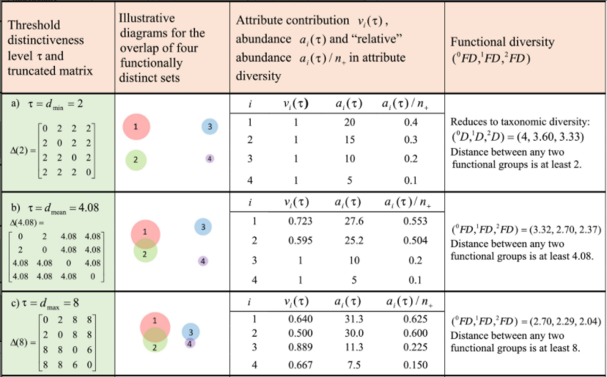
Level of threshold distinctiveness
Functional pairwise distance matrix
Effective number of distinct species
Threshold distinctiveness: Tau
Dmean - Chao’s proposed approach
Dmin
Taxo
i.e., mean distance of any two randomly chosen individuals based on the distance matrix
Dmax
Conventional
Chao et al 2019
Notes:
We used the suggested tau = Dmean (Chao et al., 2019), which is the mean distance of any two randomly chosen individuals based on the distance matrix (in contrast to the conventional approach which uses the maximum value of the distance matrix).

Slide 34
Functional trait diversity: trait-value-based
approach
Elizabeth Builes
@mira.pal.cielo

Slide 35
Trait-value-based approach
Measures are calculated:
Species trait values directly (e.g., aggregated-trait value; Garnier et al 2004)
Accounting for their position in a multidimensional functional space built according to their trait values (e.g., volume occupied by species; Cornwell et al. 2006).
Notes:
Two ways

Slide 36
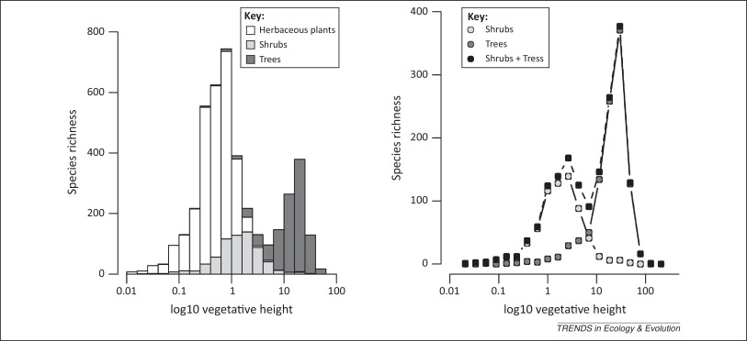
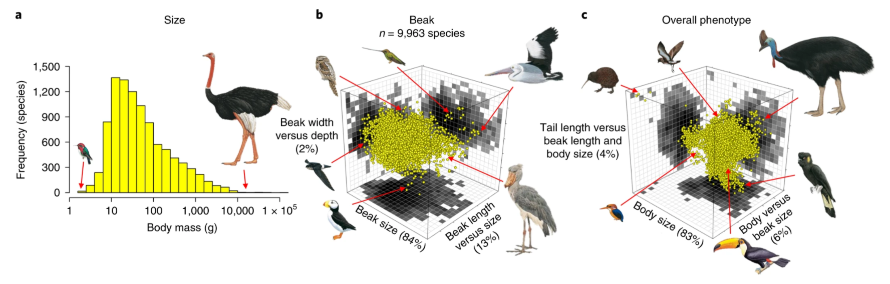
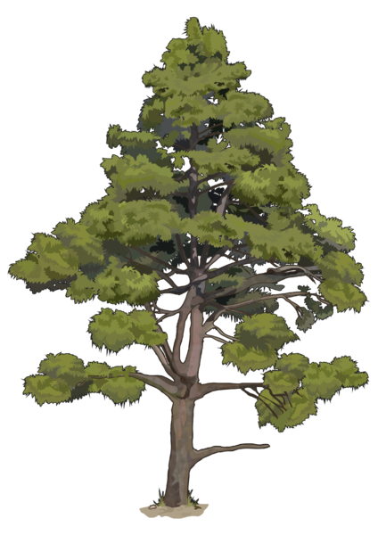

Species trait values - univariate analysis
Scheffer et al 2014.Trends in Ecology & Evolution.
Pigot et al 2020. Nature Ecology & Evolution.
Notes:
UNIVARIATE ANALYSIS
1. The value of traits refers to the presence and relative abundance of certain values of leaf size, nitrogen content, canopy heights, as in CWM.
2. The range of traits refers to the difference between extreme values of these spp characteristics, for example, the range of plant height or body mass.
LEFT: Frequency distribution of plant height for species extracted from the TRY global database of plant traits. Using the highest reported value for each species.
RIGHT: Distribution of avian body masses from the lightest (Mellisuga helenae, 2 g) to the heaviest species (Struthio camelus, 111 kg).
METHOD: a histogram or probability density distribution.

Slide 37
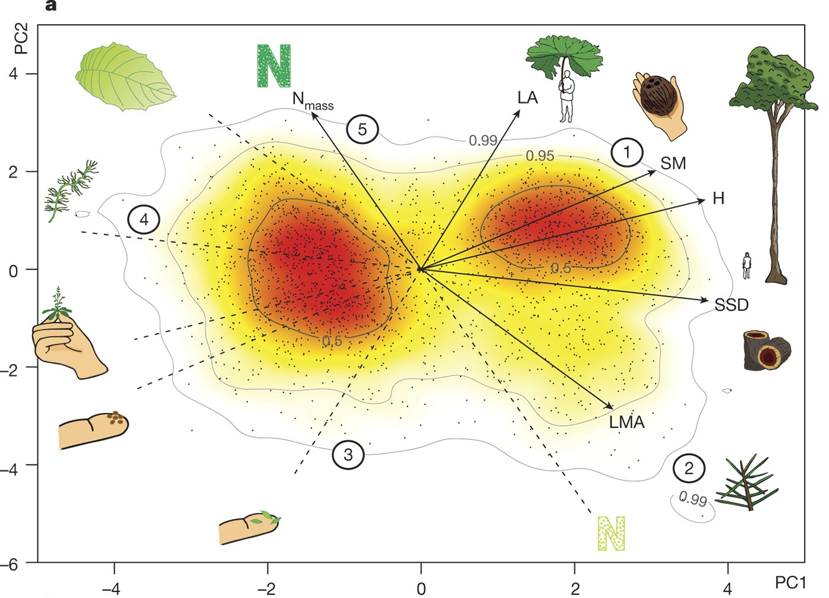
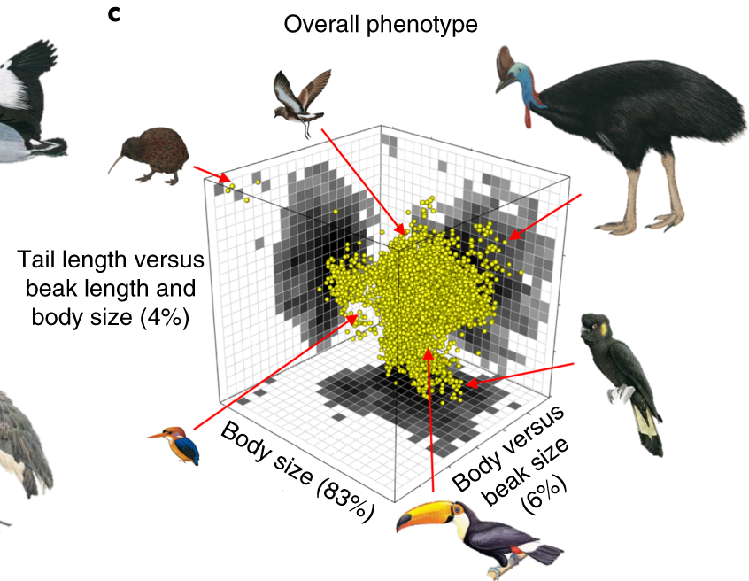
Multidimensional trait space
The plant 2D – trait space
The avian 3D - trait space
Díaz et al. 2016. Nature.
Pigot et al 2020. Nature Ecology & Evolution.

Slide 38
Species trait combinations
Investments strategies
Conservative
Big plants
Slow-return (conservative)
Fast-return (acquisitive)
Leaf construction
Respiration
Nitrogen concentration
Photosynthesis
Small plants
Acquisitive
Lifespan

Slide 39
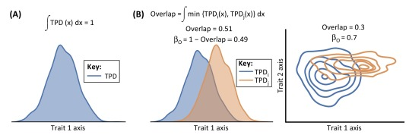
Functional diversity quantification
Univariate analysis
Carmona et al 2016. Trends in ecology & evolution.
Notes:
How can we measure functional diversity?
1. We can do an univariate per analysis per trait.
The -trait probability density TPD- is the relative abundance of trait values.
We can calculate the dissimilarity among traits by calculating the overlap between two TPD functions (i and j). Because TPD functions integrate to 1, the dissimilarity between two ecological units (β_{O}) can be calculated as 1-overlap.
Carmona, C. P., De Bello, F., Mason, N. W., & Lepš, J. (2016). Traits without borders: integrating functional diversity across scales. Trends in ecology & evolution, 31(5), 382-394.

Slide 40
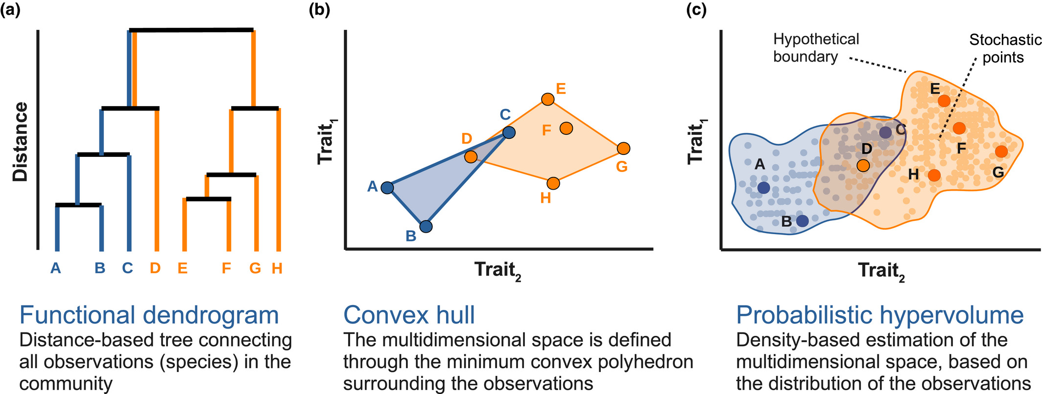
Functional diversity quantification
Multivariate analysis
Mammola & Cardoso (2020). Methods in Ecology and Evolution
Notes:
How can we measure functional diversity?
1. We can do an multivariate analysis with several traits.
Here I show you two examples of mathematical representations of functional diversity (FD) of communities.
Examples are based on two hypothetical traits and two communities, represented in blue and orange.
LEFT: The trait space represented as the minimum convex hull comprising the species occupying the trait space. The functional richness of a community is estimated as the area of the convex hull.
RIGHT: The trait space can be constructed using kernel density hypervolumes, whereby it is approximated as a cloud of stochastic points sampled based on a set of observations (e.g. the traits of the species in the community). The functional richness of the community is estimated as the volume of the hypervolume delineated by the stochastic points
Mammola, S., & Cardoso, P. (2020). Functional diversity metrics using kernel density n‐dimensional hypervolumes. Methods in Ecology and Evolution.

Slide 41
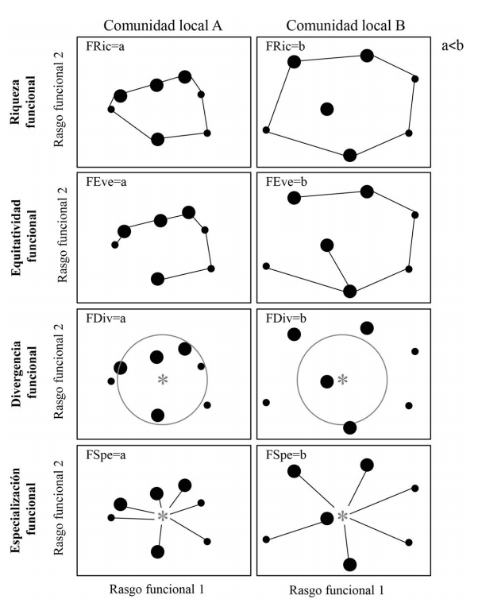
Functional diversity components
Functional richness: total volume of trait space occupied by the species present in a community.
„Convex hull volume“
„Hypervolume“
Community A
Community B
Trait 2
Trait 1
Trait 1
Modified from Villéger et al 2008. Ecology

Slide 42
Functional diversity components
Functional evenness: how regular the distribution of species abundances in traits space is.
Community A
Community B
a<b
Trait 2
Trait 1
Trait 1
Modified from Villéger et al 2008. Ecology
Notes:
Functional evenness (FEve; B) is an indicator of evenness in the distribution of abundance within occupied functional trait space.
Communities where all trait values have a similar probability should have high FEve values.
High FEVE = No dominance of plant strategies

Slide 43
Functional diversity components
Functional dispersion: position of species relative to center of trait space.
Mean distance to centroid
Centroid depends on species abundance. Abundant species have higher weight
Community A
Community B
a<b
Trait 2
Trait 1
Trait 1
Modified from Villéger et al 2008. Ecology
Notes:
High functional divergence indicates a high degree of differentiation. Different plant strategies
communities with high functional divergence may have increased ecosystem function as a result of more efficient resource use. and thus low resource competition.

Slide 44
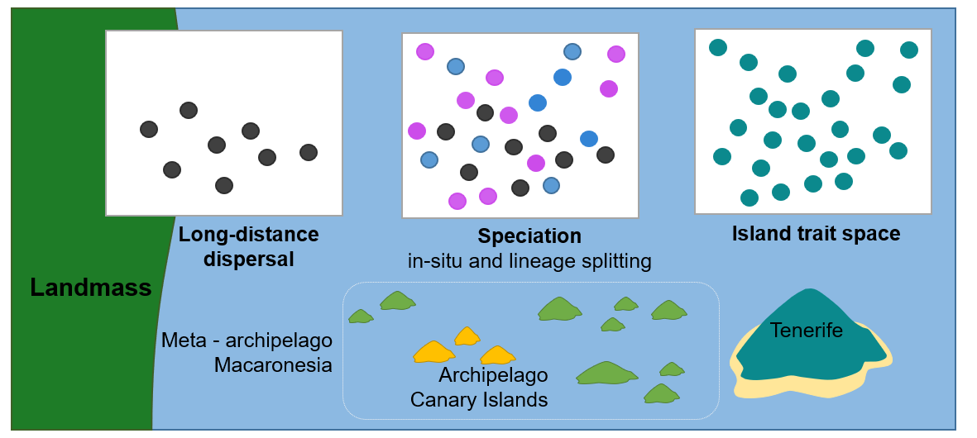
Long-distance and inter-island dispersal drive functional divergence of an oceanic island flora
Barajas-Barbosa et al. in prep.

Slide 45
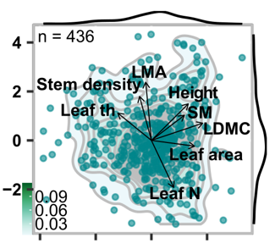
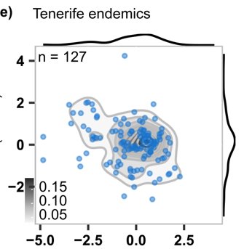
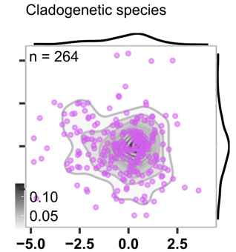
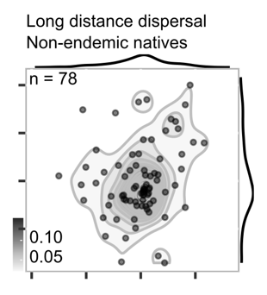
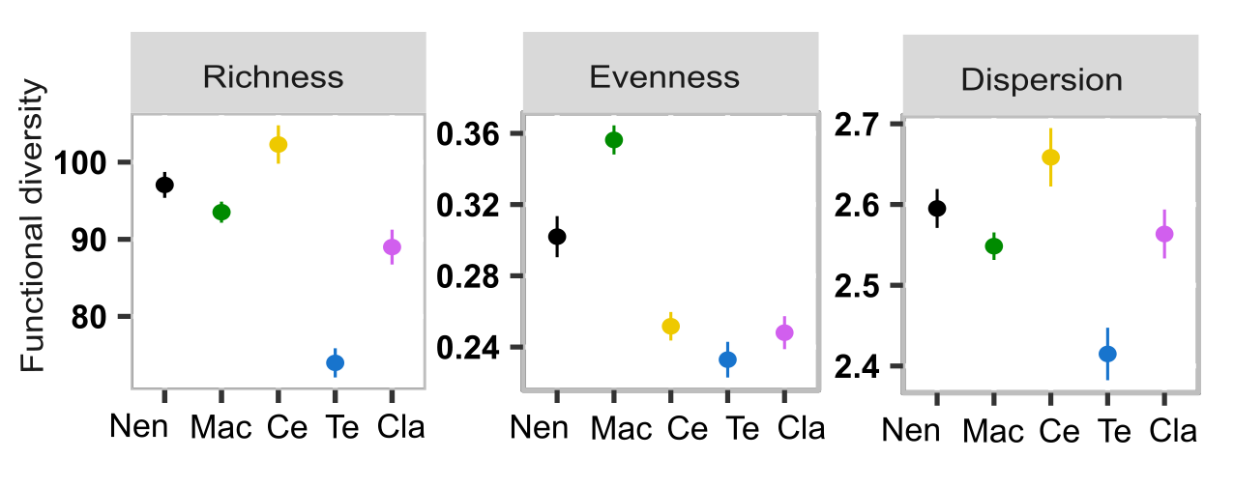
Long-distance dispersal
Non-endemic natives
Speciation
in-situ and lineage splitting
Island trait space
Barajas-Barbosa et al. in prep.

Slide 46
Exercise

Slide 47
Functional diversity quantification
Functional richness (volume)
Convex hull
Hypervolume
Blonder 2018
Laliberté et al approach
Blonder approach
It detects possible holes in the trait space.
Notes:
Functional diversity can be measured as the total volume occupied by the hypervolume in multi-dimensional space.
Estimates the minimum convex hull that includes all species in the analysis (Villeger et al 2008). Driven by extreme trait combinations.
But, convex hulls are determined by extreme points and cannot account for possible holes in the trait space.
Gaussian method to build the hypervolumes, as it is the least sensitive method to variation in bandwidth and fits the data loosely, which is suitable for functional diversity and fundamental niche modelling applications (Blonder et al. 2018)

Slide 48
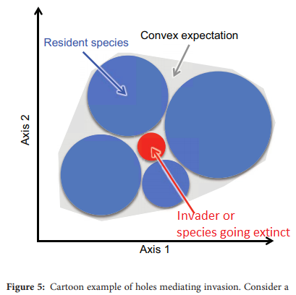
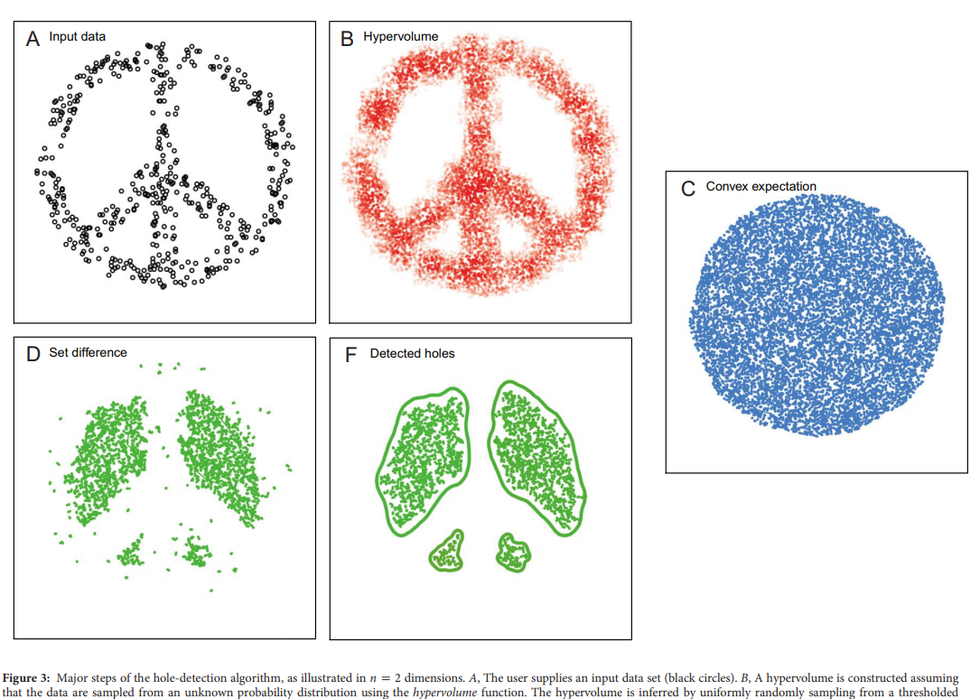
Functional diversity quantification
Do hypervolumes have holes?
Blonder 2016
Notes:
What is the ecological and evolutional meaning of the holes? https://www.journals.uchicago.edu/doi/pdfplus/10.1086/685444
If we dont detect holes we may be overstimating functional diversity. This can lead to wrong comparisons.
Additionally:
Does invasion occur in holes?
Do Species’ Niches Evolve Holes?
Climate change, when describing environmental space of species, holes indicate species do not inhabit these places, e.g., a hypothesis is that species with potential climate niches falling completely within a hole might not be able to migrate to nearby regions with more favorable climate and so become locally extinct (Burrows et al. 2014).

Slide 49
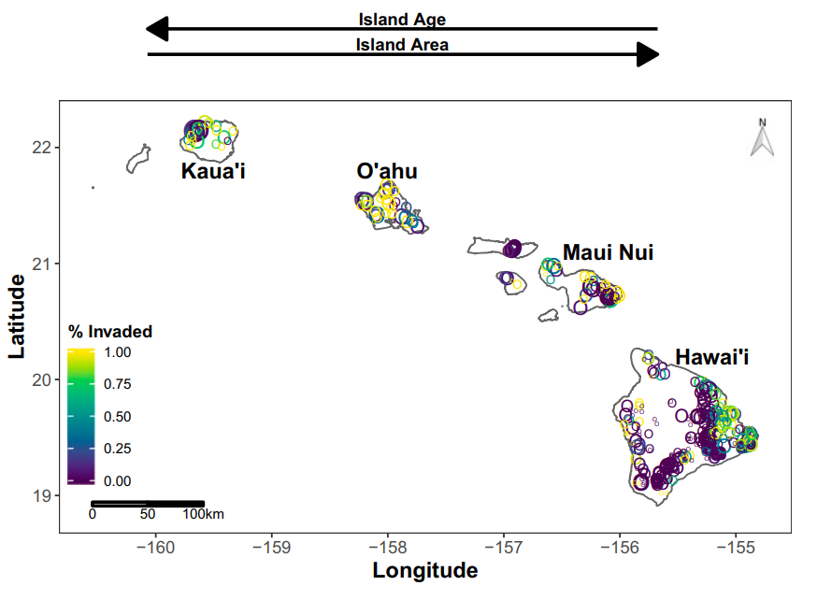
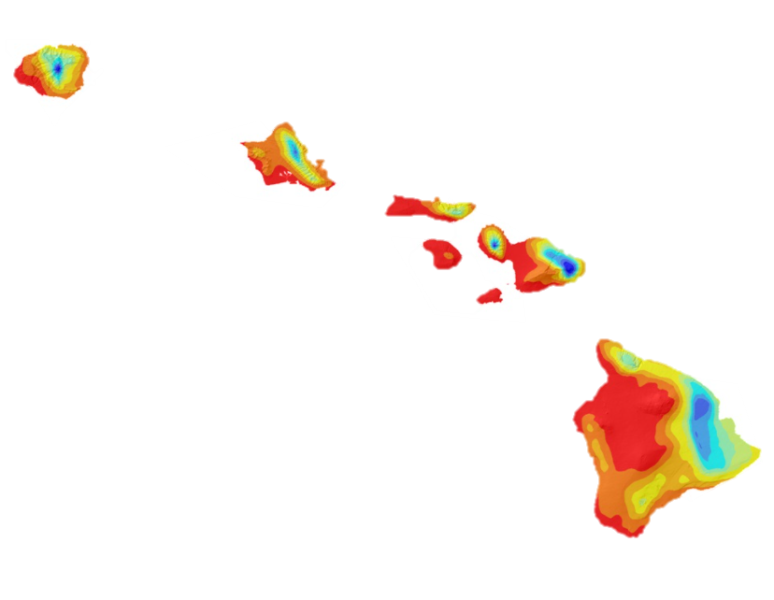
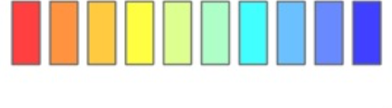
Hawaiian Island – Model system
Kaua’i
O’ahu
5 Ma
Maui Nui
Hawai’i
0.5 Ma
Annual rainfall (mm)
200 3500 10000
Giambelluca et al. 2013
Craven et al. 2019
Located ca 3000 km from the nearest continent
Background
Notes:
This project is on the Hawaiian islands
Excellent model system
One of the most isolated oceanic archipelagos on earth: 3,000 km from the nearest continent.
Islands have large gradient of ages and sizes, from 0.5 to 5 Ma.
Very steep gradient of precipitation: ranging from 200 to more than 11 thousand mm of annual rain a year.
LEFT: blue colors represent humid to super humid areas on the islands.
-----------------------------
Missing: Maloka’i, Lana’i, Kaho’olawe

Slide 50
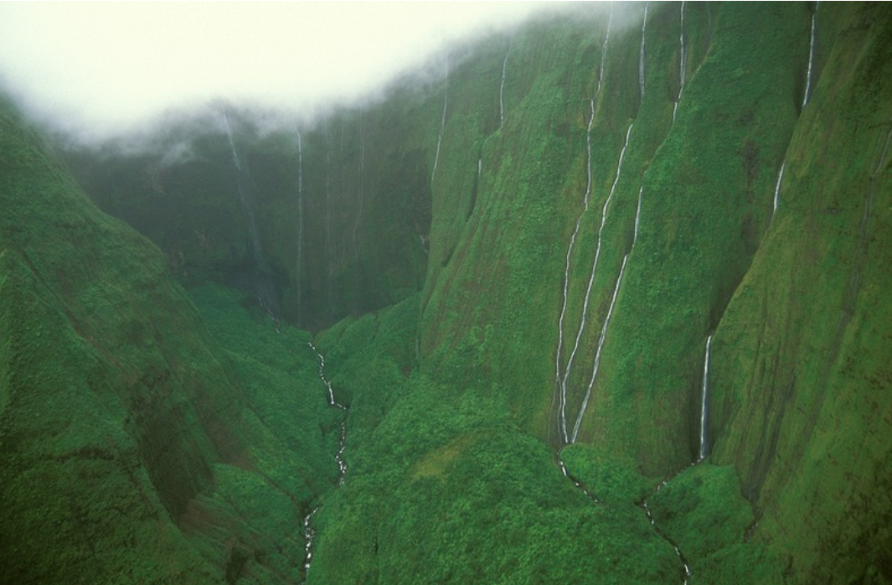
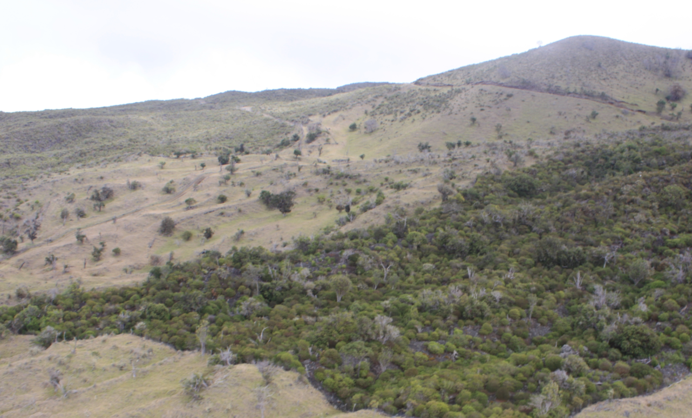
Hawaiian Islands
Kaua’i
O’ahu
Mount of Tears Kaua’I
> 11000 mm of rainfall annually
Maui Nui
Hawai’i
Annual rainfall (mm)
200 3500 10000
Auwahi Dryland
Maui
Located ca 3000 km from the nearest continent
https://www.amusingplanet.com/2013/06/wall-of-tears-mount-waialeale-hawaii.html
Background

Slide 51
Do trait values change across gradients of rainfall?
Research question
Notes:
I set me research question.

Slide 52
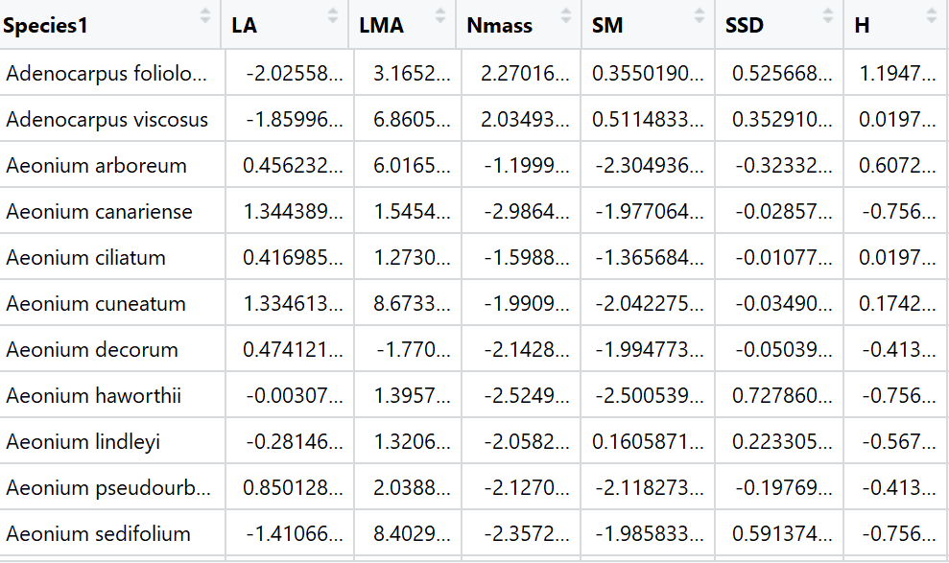
How to estimate functional diversity?
1
Prepare your data
Species by trait Matrix
z –log transformations
Deal with missing values
E.g., use trait imputation
Notes:
How to estimate HV following Blonder approcah
1. Collect/gather you traits.
2. Use tranformation if you trait-data has different order of magnitude. For intance seed mass: there are plants with microscopic seeds (micrograms), to plants with seeds heavier than 20 kg.
3. Deal with missing values. Ideally you impute/predict missing values because delete species with missing data for the calculation of diversity indices may introduce bias (Taugourdeau et al 2014).

Slide 53


How to estimate functional diversity?
2
Reduce dimensionality using PCA analysis.
Use the first 3 components to estimate hypervolumes.
Or decide which traits will be included in the analysis (orthogonal traits?).
PCA analysis using 10 plant traits and 439 native species of Tenerife island.
Notes:
You should use the lowest dimensionality possible for the Blonder approach.

Slide 54
How to estimate functional diversity?
3
library(hypervolume) estimation functional diversity
Principal coordinates analysis is performed on the species-species distance matrix.
The resulting PCA axes are used as the new ‘traits’ to compute the three indices Functional richness, evenness and dispersion
https://benjaminblonder.org/hypervolume_faq.html
Notes:
FD A distance-based framework to compute multidimensional functional diversity
Once the species-species distance matrix is obtained, if variables are continuous then axes can be represented in Euclidean space.
Principal coordinates analysis (PCoA) is performed on the corrected species-species distance matrix. The resulting PCoA axes are used as the new ‘traits’ to compute the three indices of Villéger et al. (2008): FRic, FEve, and FDiv. For FEve, there is no limit on the number of traits that can be used, so all PCoA axes are used.
While PCA is based on Euclidean distances, PCoA can handle (dis)similarity matrices calculated from quantitative, semi-quantitative, qualitative, and mixed variables.

